Slide 1

Copyright © 2016 Pearson Education, Inc.

Slide 2

Section 4: Putting the Business Plan to Work: Sources of Funds
Section 3: Launching the Business
13
Sources of Financing:
Equity and Debt
Copyright © 2016 Pearson Education, Inc.
13-2

Slide 3
Learning Objectives
Describe the difference between equity capital and debt capital.
Discuss the various sources of equity capital available to entrepreneurs.
Describe the process of “going public.”
Describe the various sources of debt capital.
Describe the various loan programs available from the Small Business Administration.
Identify the various federal and state loan programs aimed at small businesses.
Explain other methods of financing a business.

Slide 4
Raising Capital
Raising capital to launch or expand a business is a challenge.
Many entrepreneurs are caught in a “credit crunch.”
Financing needs in the $100,000 to $3 million range may be the most challenging to fill.

Slide 5
The “Secrets” to Successful Financing
Choosing the right sources of capital can be as important as choosing the right form of ownership or the right location.
The money is out there; the key is knowing where to look.
Raising money takes time and effort.
Creativity counts. Entrepreneurs have to be as creative in their searches for capital as they are in developing their business ideas.
The Internet puts at entrepreneur’s fingertips vast resources of information that can lead to financing.

Slide 6
The “Secrets” to Successful Financing
(continued)
Put social media to work to locate potential investors.
Be thoroughly prepared before approaching lenders and investors.
Entrepreneurs cannot overestimate the importance of making sure that the “chemistry” among themselves, their companies, and their funding sources is a good one.
Plan an exit strategy.
When capital gets tight remember to bootstrap.

Slide 7
Financing a Business
Entrepreneurs must cast a wide net to capture the financing they need to launch their businesses.
Layered financing:
Piecing together capital from multiple sources.
Capital:
Any form of wealth employed to produce more wealth.
Two types:
Equity
Debt

Slide 8
Equity Capital
Equity capital:
Represents the personal investment of the owner(s) in the business.
Called risk capital because investors assume the risk of losing their money if the business fails.
Does not have to be repaid with interest like a loan does.
But, the entrepreneur must give up some ownership in the company to outside investors.

Slide 9
Debt Capital
Debt capital:
Must be repaid with interest.
Is carried as a liability on the company’s balance sheet.
Can be just as difficult to secure as equity financing, even though sources of debt financing are more numerous.
Can be expensive, especially for small companies, because of the risk/return tradeoff.

Slide 10
Sources of Equity Financing
Personal savings

Slide 11
Personal Savings
The first place an entrepreneur should look for money.
Bootstrapping
The most common source of equity capital for starting a business.
Outside investors and lenders expect entrepreneurs to put some of their own capital into the business before investing theirs.

Slide 12
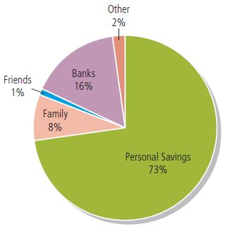
Sources of Financing for Typical Start-Up Businesses

Slide 13
Sources of Equity Financing
(continued from 13-10)
Personal savings
Friends and family members

Slide 14
Friends and Family Members
After emptying their own pockets, entrepreneurs should turn to those most likely to invest in the business: friends and family members.
Be careful! Inherent dangers lurk in family/friendly business deals, especially those that flop.

Slide 15
Family and Friendship Financing
Choose your financier carefully.
Keep the arrangement “strictly business.”
Prepare a business plan.
Settle the details up front.
Create a written contract.
Treat the money as “bridge financing.”
Develop a payment schedule that suits both parties.
Have an exit plan.

Slide 16
Sources of Equity Financing
(continued from 13-13)
Personal savings
Friends and family members
Crowd funding

Slide 17
Crowd Funding
Crowd funding:
Taps the power of social networking and allows entrepreneurs to post their elevator pitches and proposed investment terms on specialized Web sites and raise money from ordinary people who invest as little as $100.
The returns for investment are tokens – discount coupons and free samples.
Jumpstart Our Business Startups (JOBS) Act expands the use of crowd funding.

Slide 18
Sources of Equity Financing
(continued from 13-16)
Personal savings
Friends and family members
Crowd funding
Accelerators

Slide 19
Accelerators
Accelerator programs:
Provide a small amount of seed capital and a wealth of additional support for start-up companies.
Offer a structured program that lasts from three months to one year.
The most important contribution is the coaching and mentoring received.
Examples: Y Contributor and TechStars

Slide 20
Sources of Equity Financing
(continued from 13-18)
Personal savings
Friends and family members
Crowd funding
Accelerators
Angels

Slide 21
Angels
Angels:
Wealthy individuals who invest in emerging entrepreneurial companies in exchange for equity (ownership) stakes.
An excellent source of “patient money” for investors needing relatively small amounts of capital typically ranging from $100,000 (sometimes less) to as much as $5 million.
Willing to invest in the early stages of a business.

Slide 22
Angels
(continued)
An estimated 299,000 angels across the United States invest $24.8 billion a year in 70,000 small companies.
Their investments exceed those of venture capital firms, providing more capital to 18 times as many small companies.
Angels fill a gap in the seed capital market, specifically in the $10,000 to $2 million range.

Slide 23
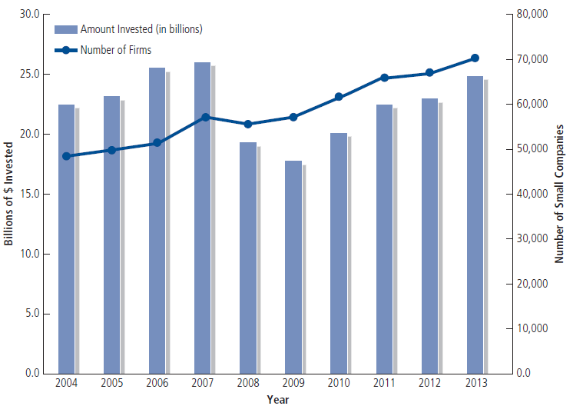
Angel Financing

Slide 24
Angels
(continued from 13-22)
Angels accept between 10 and 15% of the deals that are pitched to them.
Average angel investment is $50,000 in a company that is in the seed or start-up growth stage.
52% of angels’ investments lose money, but 7% produce a return more than 10 times their original investment.
Angels can be an excellent source of “patient” money.

Slide 25
Angels
(continued)
The Challenge: Finding angels!
Network
Look nearby: within a 50- to 100-mile radius
7 out of 10 angels invest in companies that are within 50 miles of their homes or offices.
Informal angel “clusters” and networks
300 angel groups across the United States
Internet

Slide 26
Sources of Equity Financing
(continued from 13-20)
Personal savings
Friends and family members
Crowd funding
Accelerators
Angels
Venture capital companies

Slide 27
Venture Capital Companies
Venture capital companies:
Private, for-profit companies that purchase equity positions in young businesses that they believe have high-growth and high-profit potential.
More than 400 operate across the United States
Most venture capitalists seek investments in the $5 million to $25 million range
Target companies with high-growth and high-profit potential.
Business plans are subjected to an extremely rigorous review - less than 1% accepted.

Slide 28
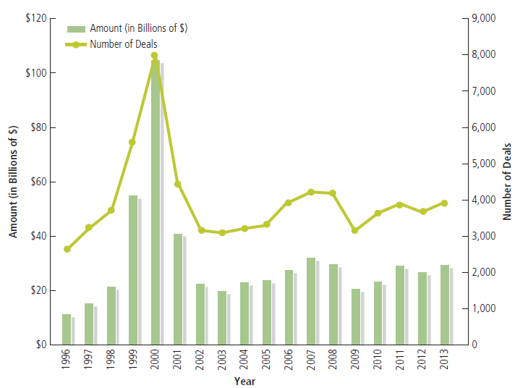
Venture Capital Funding

Slide 29
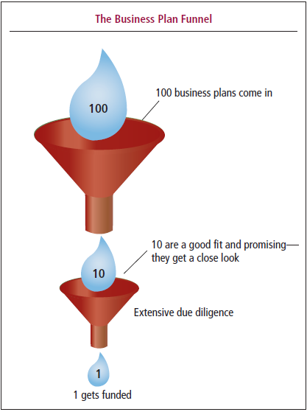
The Business Plan Funnel

Slide 30
Venture Capital Companies
(continued from 13-27)
Most often, venture capitalists invest in a company across several stages.
On average, 96-98% of venture capital goes to:
Early stage investments (companies in the early stages of development).
Expansion stage investments (companies in the rapid growth phase).
Only about 2% of venture capital goes to businesses in the startup or seed phase.

Slide 31
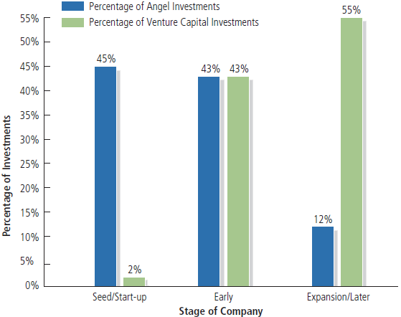
Angel vs. VC Investments

Slide 32
What Do Venture Capital Companies Look For?
Competent management
Competitive edge
Growth industry
Viable exit strategy
Intangibles factors

Slide 33
Sources of Equity Financing
(continued from 13-26)
Personal savings
Friends and family members
Crowd funding
Accelerators
Angels
Venture capital companies
Corporate venture capital

Slide 34
Corporate Venture Capital
About 300 large corporations across the globe invest in start-up companies.
More than 17% of all VC deals involve corporate venture capital.
Capital infusions are just one benefit; corporate partners may share marketing and technical expertise.

Slide 35
Sources of Equity Financing
(continued from 13-33)
Personal savings
Friends and family members
Crowd funding
Accelerators
Angels
Venture capital companies
Corporate venture capital
Public stock sale

Slide 36
Going Public
Initial public offering (IPO):
When a company raises capital by selling shares of its stock to the public for the first time.
Since 2001, the average number of companies making IPOs each year is 120.
Few companies with less than $25 million in annual sales make IPOs.

Slide 37
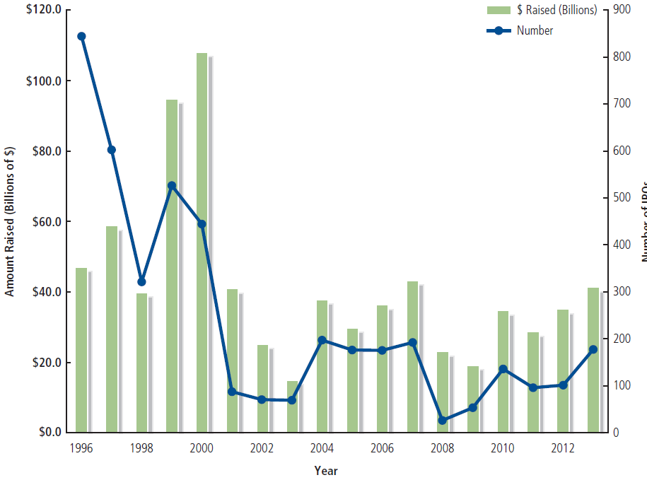
Initial Public Offerings

Slide 38
Characteristics of Successful IPO Candidates
Consistently high growth rates
Scalability
Strong record of earnings
3 to 5 years of audited financial statements that meet or exceed SEC standards
Solid position in a rapidly-growing industry:
Average company age is 10 years
Sound management team with experience and a strong board of directors

Slide 39
Steps to Take a Company Public
Choose the underwriter
Negotiate a letter of intent
Prepare the registration statement
File with the SEC
Wait to “go effective”
Road show
Sign underwriting agreement
Meet all state requirements

Slide 40
Nonpublic Registrations and Exemptions
Regulation D
Goal: To give small companies easy access to capital markets with simplified registration requirements.
Rule 504
Rule 505
Rule 506

Slide 41
The Nature of Debt Financing
Debt financing is a popular tool used by entrepreneurs to acquire capital.
Borrowed capital allows entrepreneurs to maintain complete ownership of their businesses, but must be repaid with interest.
Small businesses are considered more risky than corporate customers.
Prime rate

Slide 42
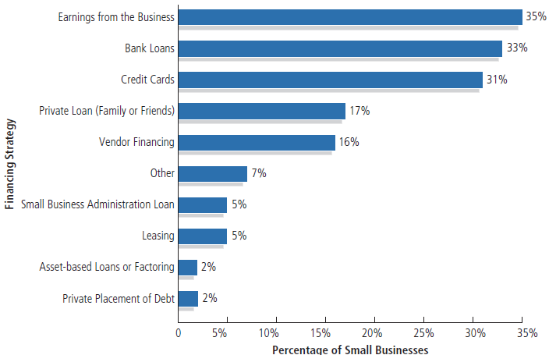
Small Business Financing Strategies

Slide 43
Sources of Debt Capital
Commercial banks
Lenders of first resort for small businesses
Average micro-business loan = $6, 377
Average small business loan = $240,428

Slide 44
Sources of Debt Capital from Commercial Banks
Short-term loans
Home Equity Loans
Commercial Loans
Lines of Credit
Floor planning
Immediate and Long-Term Loans
Installment Loans
Term Loans

Slide 45
SBA Loan Guarantee Programs
The SBA guarantees more than 52,000 small business loans totaling more than $19 billion each year.
Aimed at entrepreneurs who can’t get conventional funding.
Average duration of an SBA loan is 12 years.
7(A) Loan Guaranty Program
Average 7(a) loan = $344, 520

Slide 46
Most Popular SBA Loan Programs
7(A) Loan Guaranty Program
Average 7(a) loan = $344, 520
Section 504 Certified Development Company Program
Designed to encourage small businesses to purchase fixed assets, expand their facilities, and create jobs.
Microloan program
Average loan is $13,000

Slide 47
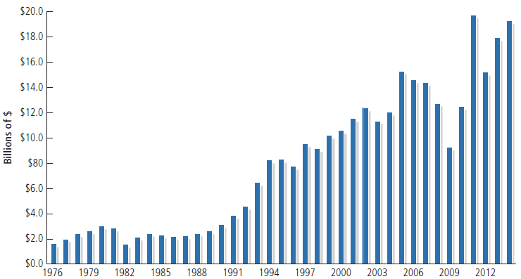
SBA 7(A) Guaranteed Loans

Slide 48
Other SBA Loan Programs
SBAExpress Program
Small Loan Advantage and Community Advantage Loan Program
The CAPline Program
Loans involving international trade
Export Express Program
Export Working Capital Program
International Trade Program
Disaster loans

Slide 49
Nonbank Sources of Debt Capital
Asset-based lenders

Slide 50
Asset Based Lenders
Businesses can borrow money by pledging as collateral otherwise idle assets – accounts receivable, inventory, and others.
Advance rate:
The percentage of an asset’s value that a lender will lend.
Discounting accounts receivable
Inventory financing
Purchase order financing

Slide 51
Nonbank Sources of Debt Capital
(continued from 13-49)
Asset-based lenders
Vendor financing (trade credit)
Equipment suppliers
Commercial finance companies
Saving and loan associations

Slide 52
Nonbank Sources of Debt Capital
(continued)
Stockbrokers
Margin loans
Margin calls
Credit unions
Private placements
Small Business Investment Companies (SBIC)

Slide 53
Federally Sponsored Programs
Economic Development Administration (EDA)
Department of Housing and Urban Development (HUD)
U.S. Department of Agriculture’s Rural Business (USDA) - Cooperative Service
Small Business Innovation Research (SBIR)
Small Business Technology Transfer programs (STTR)
State and Local Loan Development Programs
Capital Access Programs (CAPs)

Slide 54
Other Methods of Financing
Factoring Accounts Receivable:
Selling accounts receivable outright.
Leasing:
Lease assets rather than buying them to avoid tying up capital.
Rollovers as Business Startups (ROBS)
Allows entrepreneurs to use their retirement savings to fund their business start-ups.
Credit cards

Slide 55
Other Methods of Financing
(continued)
Merchant cash advance
A provider pre-purchases credit and debit card receivables at a discount.
Peer-to-peer lending
Web-based platforms that create an online community of lenders who provide funding to creditworthy small businesses.
Loan brokers
Specialize in helping small companies find loans by tapping into a wide network of lenders.

Slide 56
Conclusion
Capital is key for entrepreneurs.
In the face of a capital crunch, business’s need for capital has never been greater.
Sources of capital include:
Family and Friends
Angel Investors
Initial Public Offering
Traditional Bank Loan
Asset-based Borrowing
Federal, SBA Loans, and others

Slide 57
